Slide 1


Medical Inventory Optimization

Slide 2
Contents
Business Objective
Business Constraints
Project Architecture - Data Flow Diagram
Data Collection
Exploratory Data Analysis
Data Visualization
Notes:
Change

Slide 3
Tools
Python
Postgresql
Notes:
Change

Slide 4
Business Problem
Bounce Rate Is increasing significantly leading to patient dissatisfication
Business Objective:
Minimize bounce rate.
Maximize availability of drug, customer satisfaction, and profits.

Slide 5
Business Constraints:
Minimize Inventory Cost.
Business Problem:
Drug shortages in stocks
Increase of bounce rate

Slide 6
Why Medical Inventory is Important
It is well known that keeping precised and updated inventory records for medicines & surgical equipment is the most important task for any hospital administration. As medicines and other surgical equipment are the most used products in a hospital. Every hospital must always maintain a good stock of lifesaving medicines, injections and disposable surgical items.

Slide 7

Project Overview and Scope
Project Purpose:
Develop a Pharmaceutical Analysis model to prevent drug shortage.
Major Phases:
1.Data Preprocessing
2.Exploratory Data Analysis(EDA)
3.Visualization
Project Scope:
Analyzing the data set in order to generate the high demanding medicines supplies.

Slide 8
Data Dictionary
Field Name | Description | Data Type | Data Format | Data Size | Relevance
Typeofsales | Type of sales transaction (eg. sales,Return) | Categorical | Varchar | 10 | Transaction Classification
Patient_ID | Unique ID for each patient | Numeric | Int | 11 | Patient identification
Specialisation | Specialization of medical professional | Categorical | Varchar | 30 | Medical Context
Dept | Department in Pharmacy | Categorical | Varchar | 30 | Transaction context
Dateofbill | Date of the sales transaction | Date | YYYY-MM-DD | Date | Transaction Date
Quantity | Quantity of medicine sold | Numeric | Int | 2 | Sales Volume
ReturnQuantity | Quantity of medicine returned | Numeric | Int | 2 | Return Volume
Final_Cost | Final cost after discounts | Numeric | Decimal | 10.3 | Products Costs
Final_Sales | Final sales amount | Numeric | Decimal | 10.3 | Total transaction sales amount
RtnMRP | Maximum Retail Price of returned medication | Numeric | Decimal | 10.3 | Price Comparison
Formulation | Medication formulation | Categorical | Varchar | 10 | Product Characteristics
DrugName | Name of the drug | Categorical | Varchar | 1000 | Product Identification
SubCat | Subcategory of the drug | Categorical | Varchar | 1000 | Product Categorization
SubCat1 | Second Subcategory of the drug | Categorical | Varchar | 1000 | Datailed Categorization

Slide 9
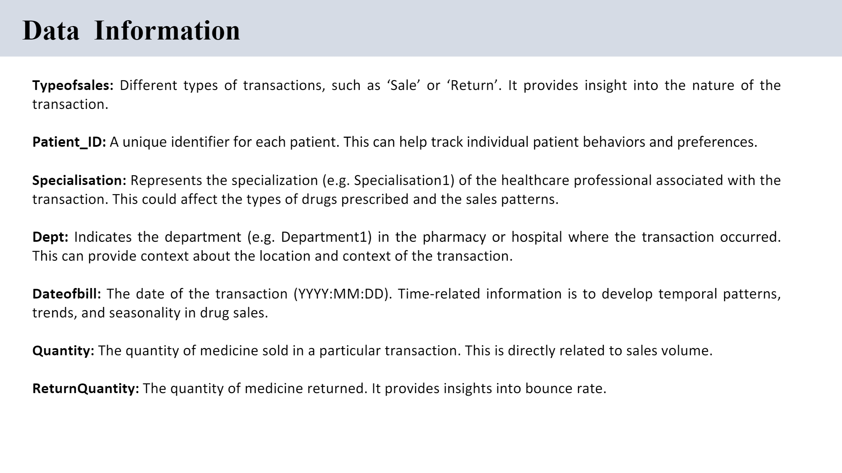
Statistical Analysis

Slide 10
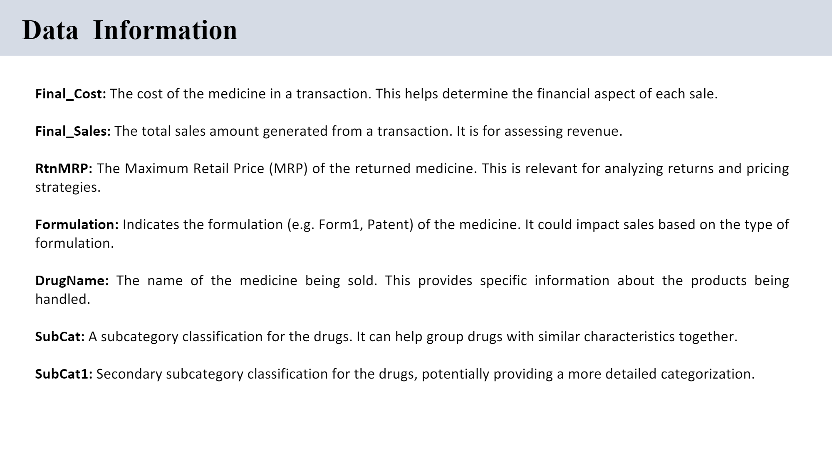

Slide 11
Statistical Analysis
First Moment Business Decision: Measure of Central Tendency
Second Moment Business Decision: Measure of Dispersion
Third Moment Business Decision: Skewness
Forth Moment Business Decision: Kurtosis

Slide 12
First Order Business Decision
Measures of Central Tendancy
Attribute | Mean | Median | Mode
Quantity | 2.2317484878323253 | 1.0 | 1
ReturnQuantity | 0.2919538613025742 | 0.0 | 0
Final_Cost | 124.82395695597131 | 53.65 | 49.35
Final_Sales | 234.0383004642003 | 86.424 | 0
RtnMRP | 29.126754958503305 | 0.0 | 0
Notes:
EDA is used for seeing what the data can tell us before the modeling task.
Change

Slide 13
Second Order Business Decision
Measures of Dispersion:
Attribute | Variance | Standard Deviation | Range
Quantity | 26.337862329084366 | 5.1320427053059845 | 150
ReturnQuantity | 2.7005064023164533 | 1.6433217586085975 | 50
Final_Cost | 216023.04539370985 | 464.78279377975025 | 33138.0
Final_Sales | 450592.09766563325 | 671.2615717182335 | 39490.0
RtnMRP | 33219.55893826576 | 182.26233548999025 | 8014.0
Notes:
EDA is used for seeing what the data can tell us before the modeling task.
Change

Slide 14
Third Order Business Decision
Skewness
Attribute | Skewness | Skew Type
Quantity | 11.34103427676747 | Positively Skewed
ReturnQuantity | 17.172364771343634 | Positively Skewed
Final_Cost | 34.508214502400946 | Positively Skewed
Final_Sales | 21.006721582359116 | Positively Skewed
RtnMRP | 15.797853037440984 | Positively Skewed
Notes:
EDA is used for seeing what the data can tell us before the modeling task.
Change

Slide 15
Fourth Order Business Decision
Kurtosis
Attribute | Kurtosis
Quantity | 180.15385837022285
ReturnQuantity | 409.41691374471526
Final_Cost | 2025.8664752637628
Final_Sales | 948.5227111226725
RtnMRP | 403.52494081462515
Notes:
EDA is used for seeing what the data can tell us before the modeling task.
Change

Slide 16
INSIGHTS:
Cleaning the data led to more stable distributions, essential for accurate decision-making.
The analysis identified a 24.9% bounce rate, indicating substantial customer dissatisfaction.
Specific subcategories like "INJECTIONS" and "TABLETS & CAPSULES" and the "Form1" formulation were identified as having high return counts.
Seasonal trends in hospital operations, with varying revenue and demand across different months, were noted.
Notes:
Keep observations

Slide 17
Data Preprocessing
Objectives:
Data Cleaning: Identify errors, inconsistencies, and missing values in the dataset.
Data Transformation: Convert data into an appropriate format or scale for analysis or modeling.
Feature Engineering: Create new relevant features or variables from the existing data to improve the performance of models.
8 data preprocessing methods were implemented:
Type Casting
Handling missing values
Removing duplicates
Handling Outliers
Label Encoding
Feature Scaling
Data manipulation
Notes:
Keep observations

Slide 18
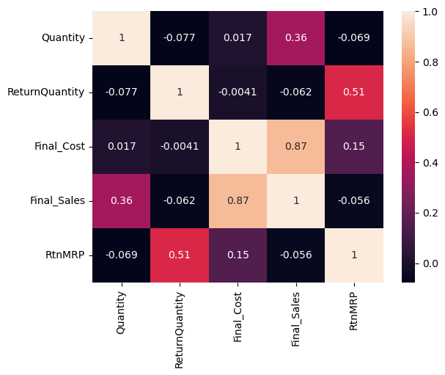
Data Visualization
HeatMap
Notes:
Add graphical

Slide 19
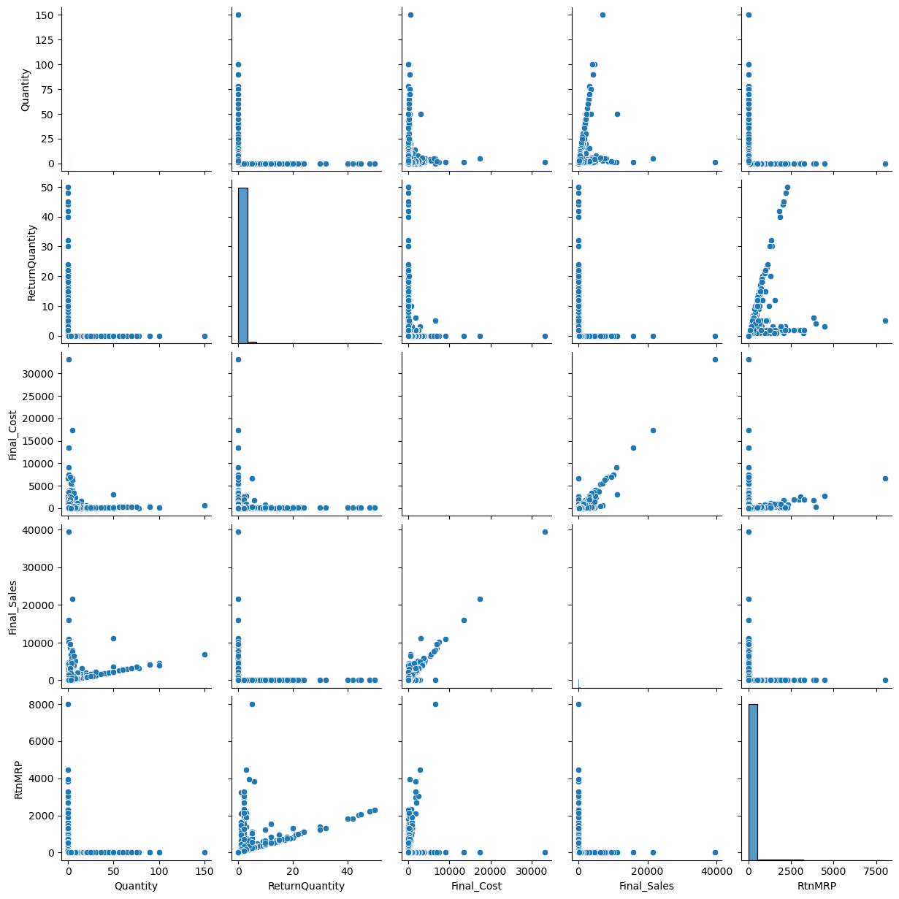
PairPlot

Slide 20
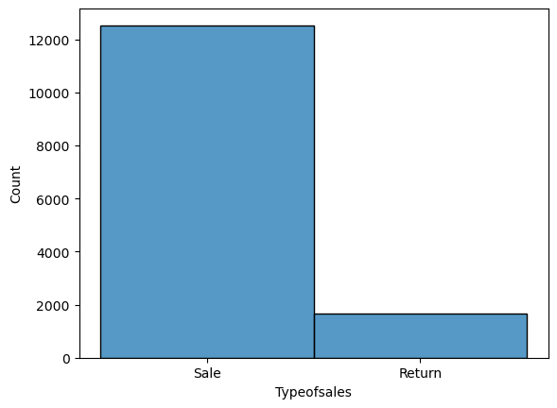
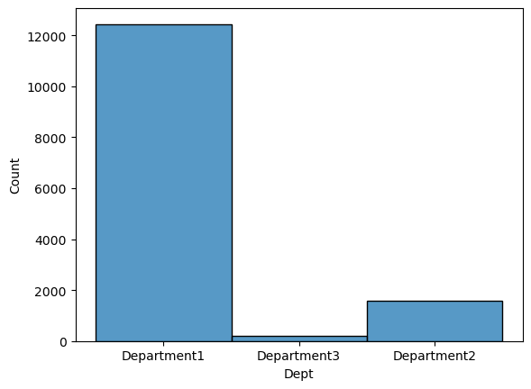
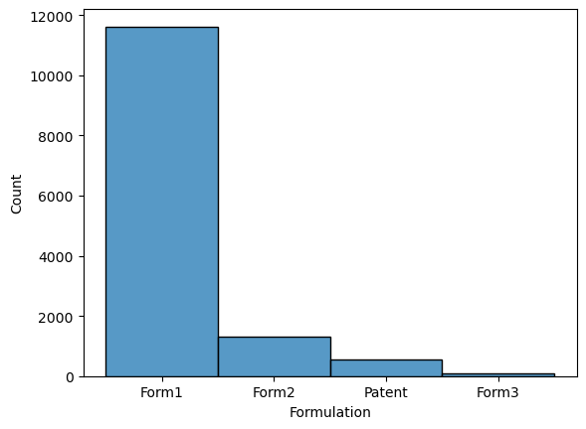
Histogram

Slide 21
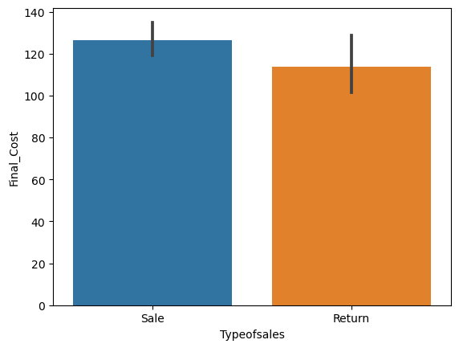
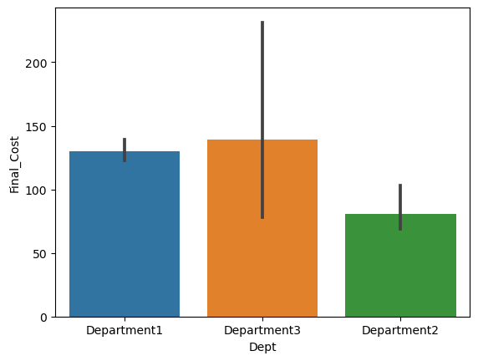
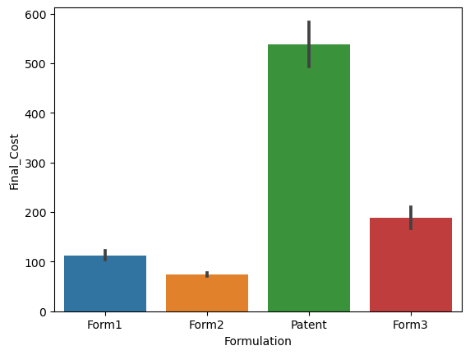
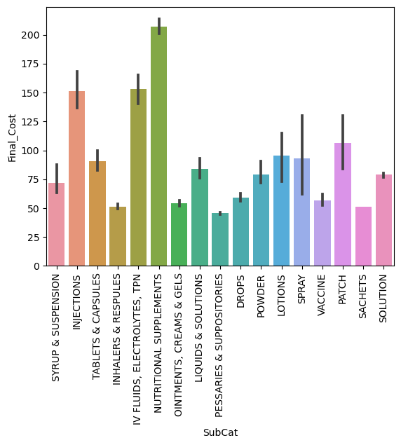
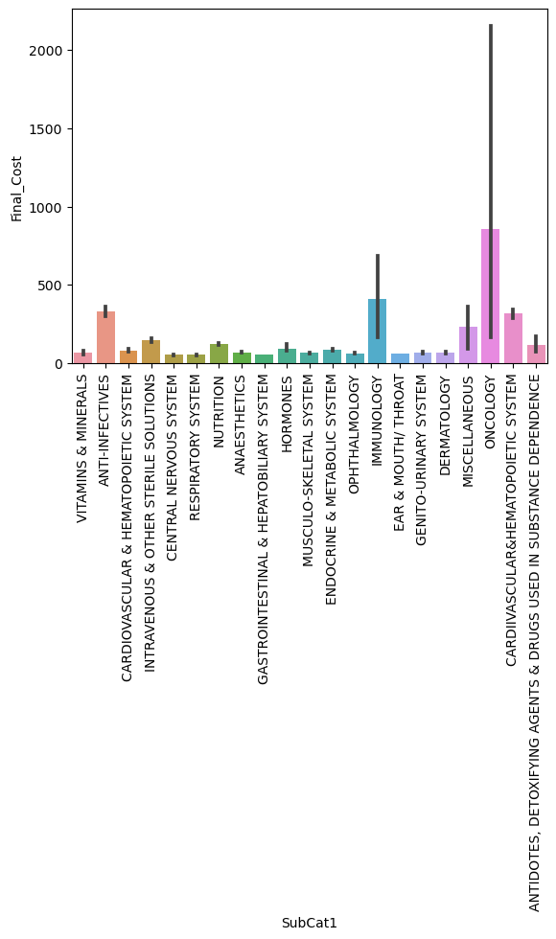
BarPlot

Slide 22
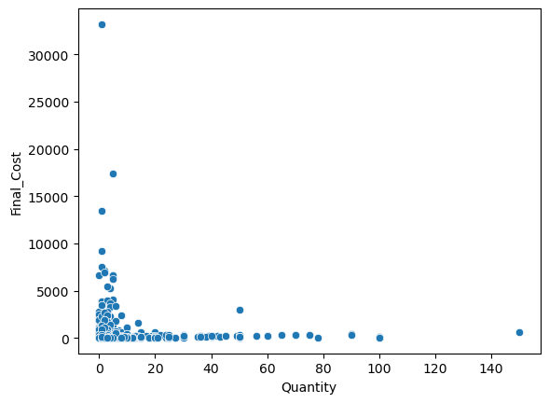
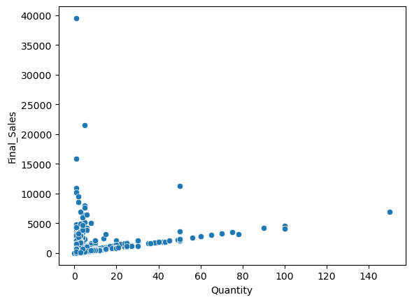
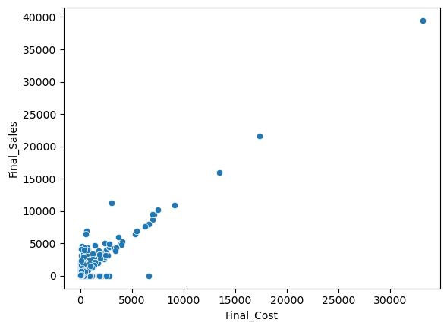
ScatterPlot

Slide 23
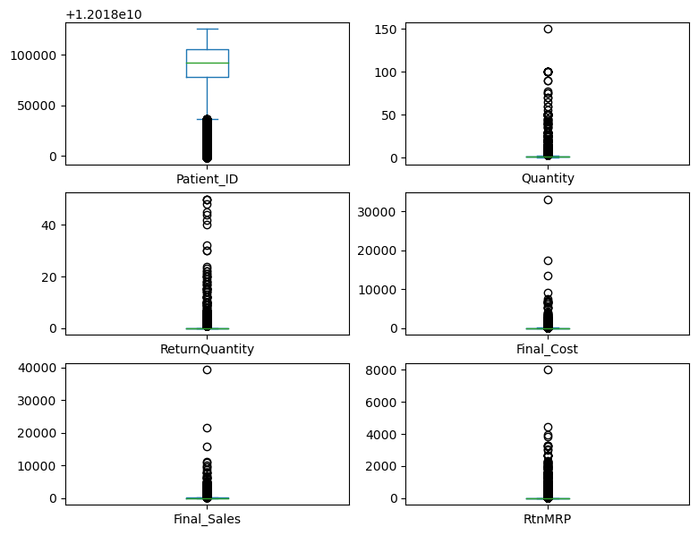
BoxPlot

Slide 24
Benefit of Inventory Management
No Stock Out situation for lifesaving medicines.
Advanced Sorting of Medicines.
Easy tracking of current stock status
Updated & Precised Stock Safer Report
Keeping track of what you need and when it's due for reordering.
Helping work out how much you need on hand at any given time, and what to order next.
Reducing wastage by making sure stock isn't being wasted or used up too quickly.

Slide 25
Final Report:
Pandas Profiling:
Pandas library offers a wide range of functions, making it an indispensable tool for data manipulation that caters to almost every task. One particularly handy feature, often employed for gaining quick insights into a dataset, is the pandas describe function. This function provides users with a descriptive statistical summary of all the features, helping them understand the data’s overall characteristics. However, for a more comprehensive analysis, an additional valuable tool in the Pandas ecosystem is the pandas profiling Package.
Link for pandas profiling:
file:///C:/Users/USER/OneDrive/Desktop/360Digitmt/eda_report.html

Slide 26


